Slide 1
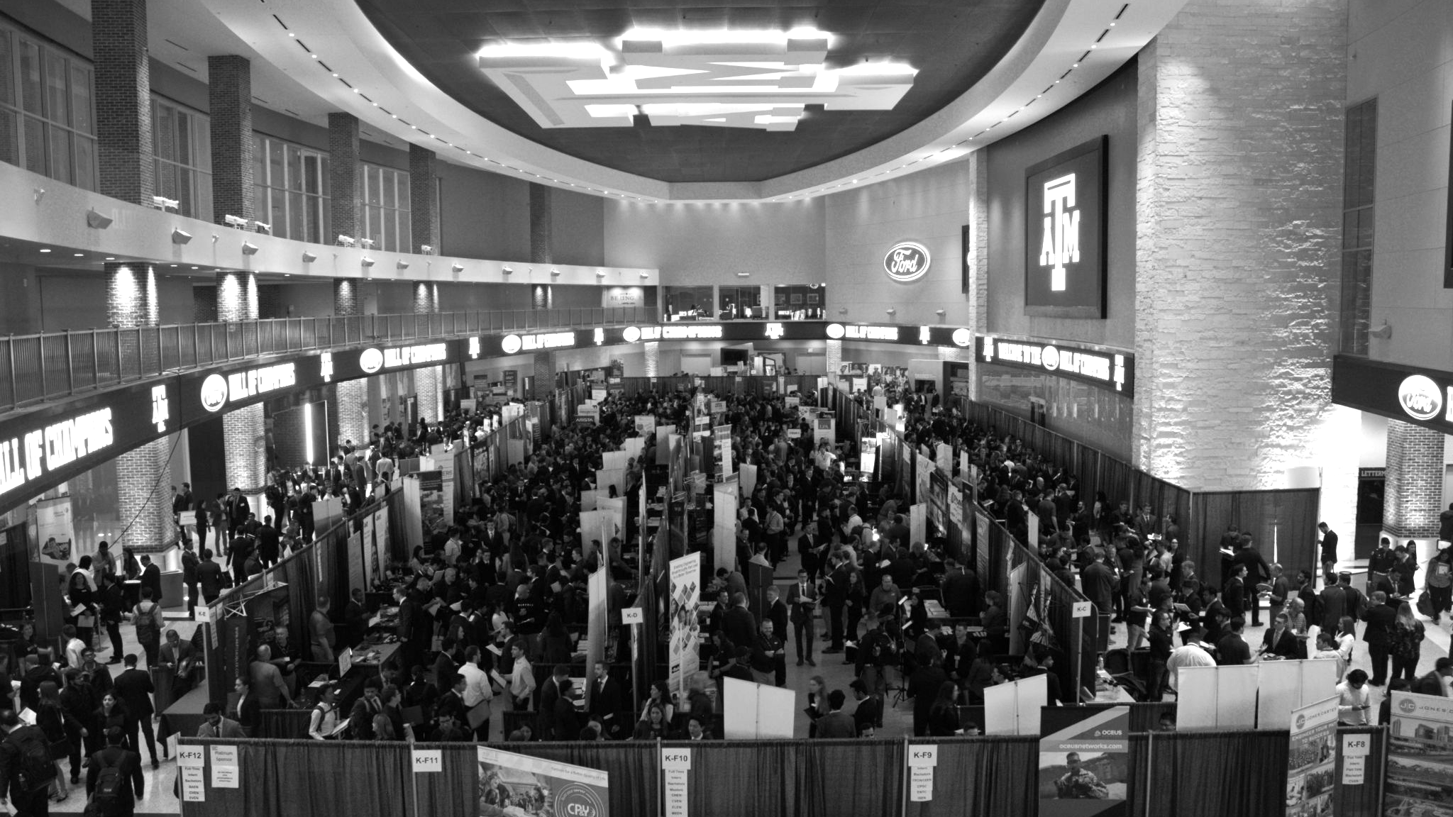

LANL Team Update
9/18/2024
Izzy Baumler, Dalton Boeckmann, Morgan Gullo, Jade Waldron

Slide 2
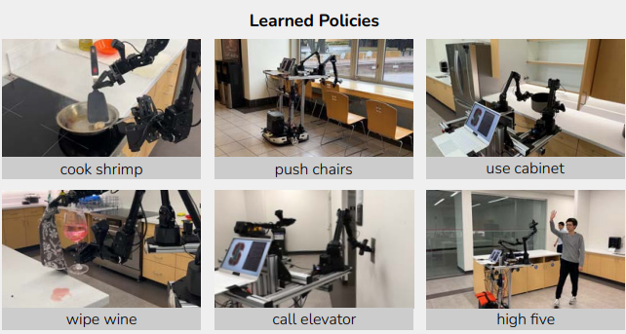
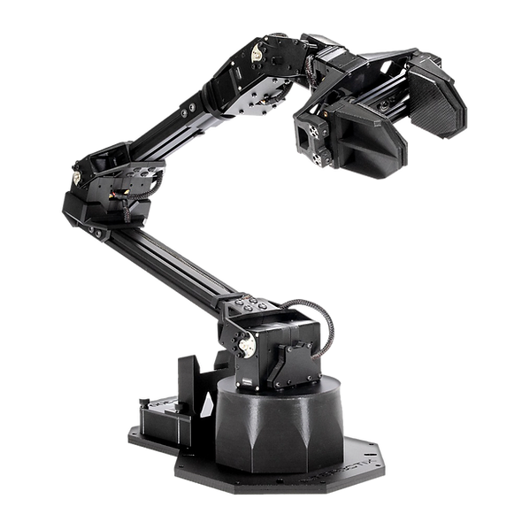
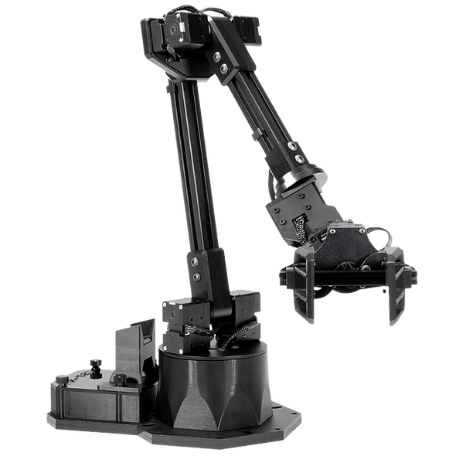
Weekly Task Updates
Finishing Functional Modelling for arm
Finishing Static Analysis of arm before our next meeting with LANL
Compiling our notes and findings from Meeting with Robotic Weed Flame PhD Students
Currently drawing inspiration from Mobile ALOHA (Bimanual Mobile Manipulation)
They utilized two arms for their research

Slide 3
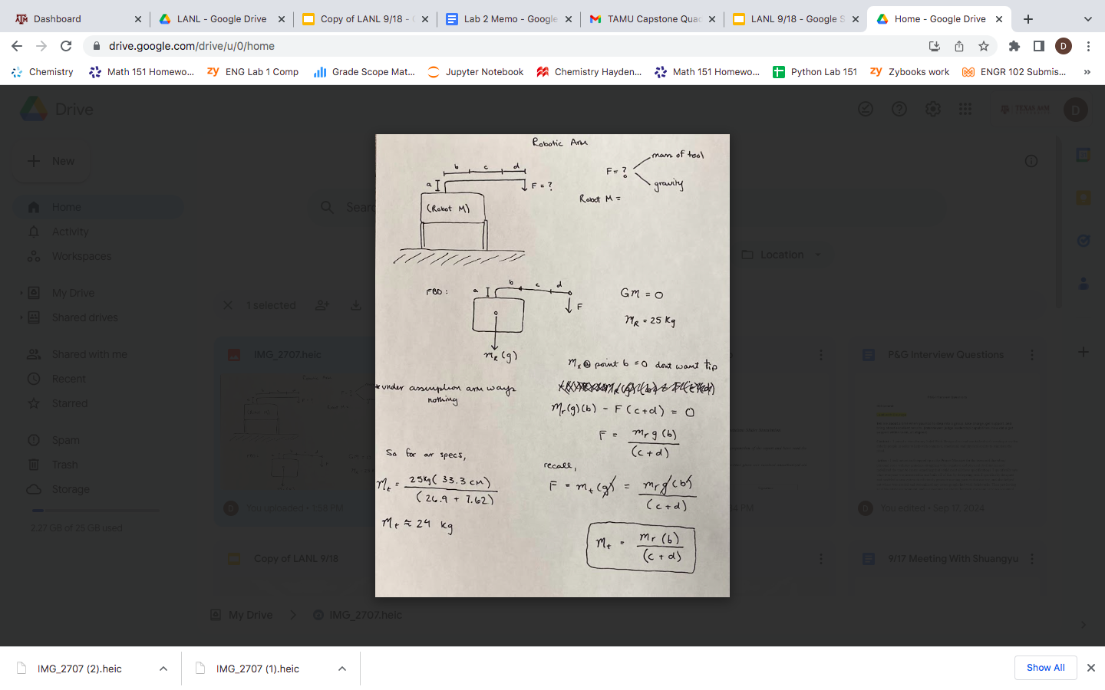
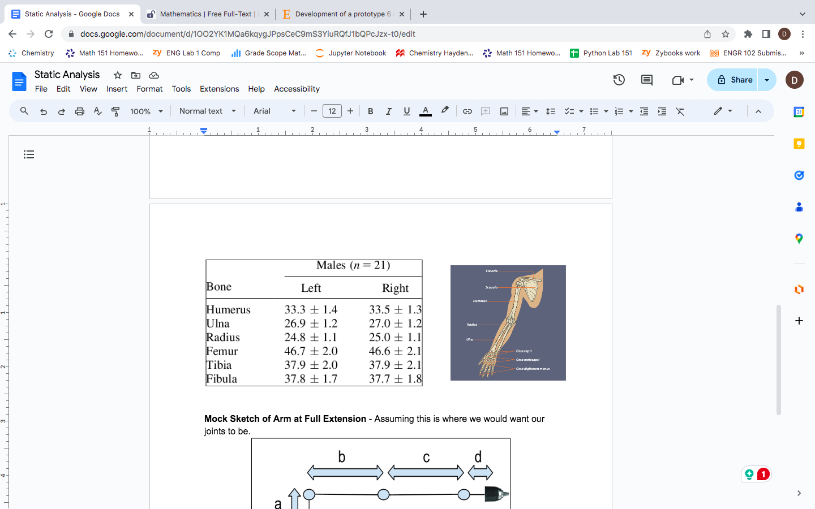
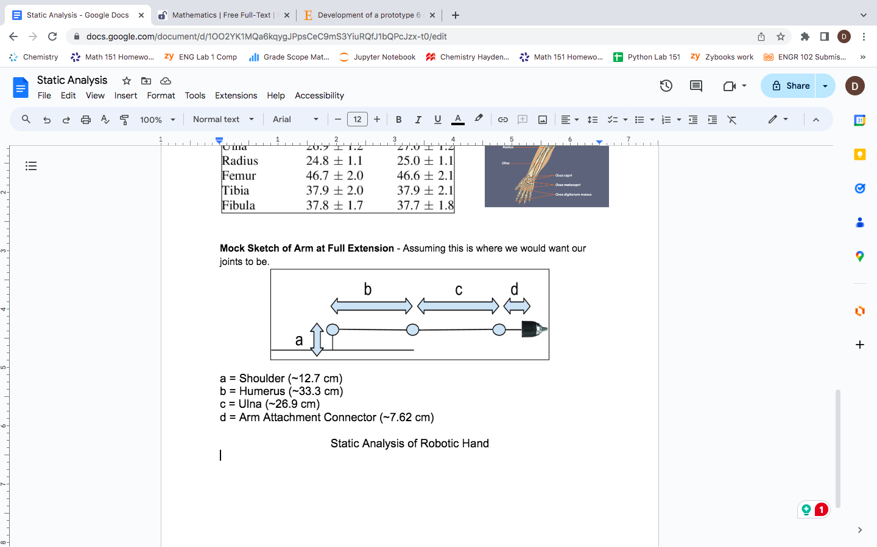
Static Analysis
Working on Static analysis, and dimensioning parameters for our arm with insight from David (Sponsor)
Performing Calculations to see how much weight the arm can withstand when its at full length, without tipping the quadruped robot

Slide 4
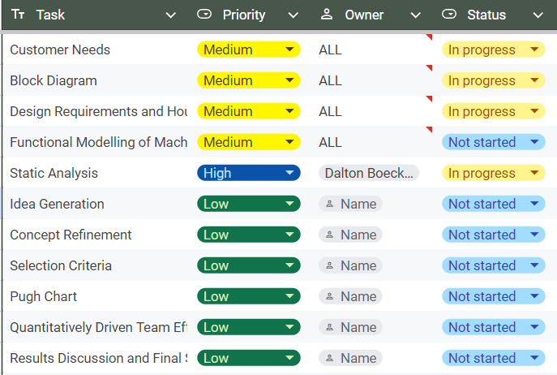
Weekly Task Updates

Slide 5
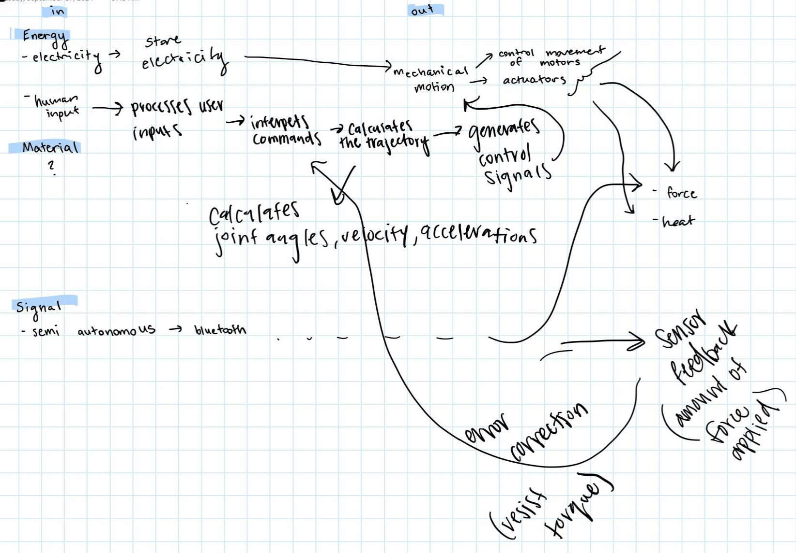
Functional Block Model Rough Draft

Slide 6
Upcoming Week
Meeting with LANL this week
Meeting with Nuclear Engineering Professor
Finalizing Functional block model
Beginning to talk to David on our thoughts for Arm configurations and designs to streamline kinematic analysis process

